Slide 1
Matlab/Octave/FreeMat: Powerful Tools for Engineering Analysis
BJ Furman
02DEC2012

Slide 2
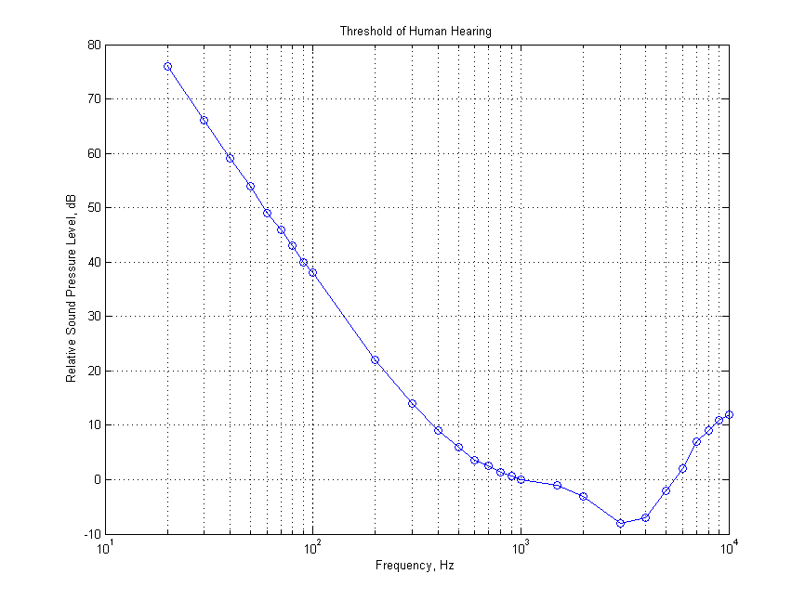
The lowest perceptible sound level of the human ear varies with frequency
At what frequency is the ear most sensitive?

Slide 3
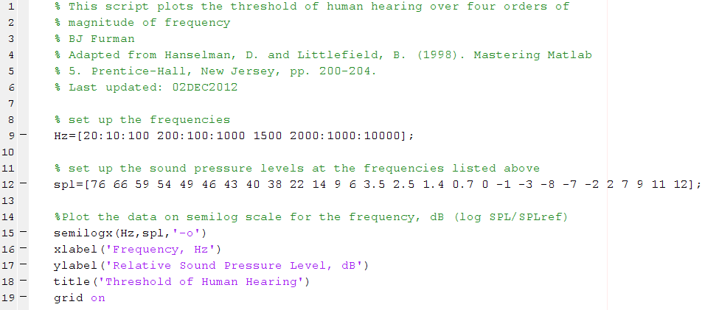
What is the Matlab code to produce the plot?

Slide 4
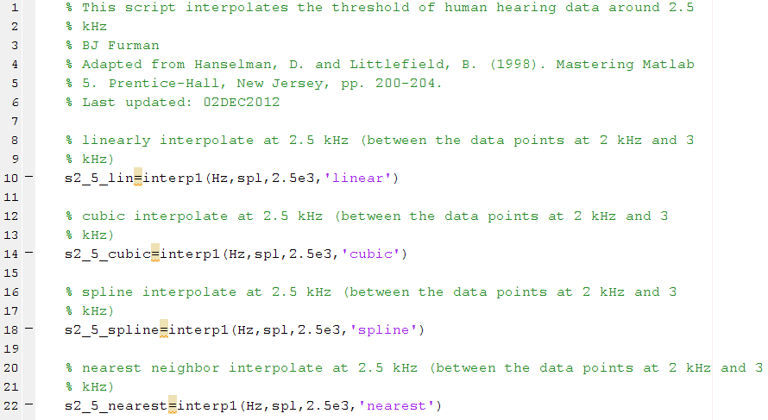
The SPL at 2.5 kHz can be found with the interpolation function interp1()

Slide 5
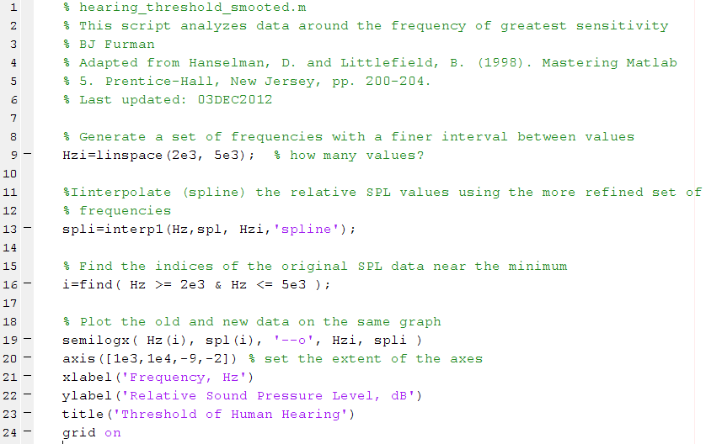
Cubic and spline interpolation is often used to smooth data

Slide 6
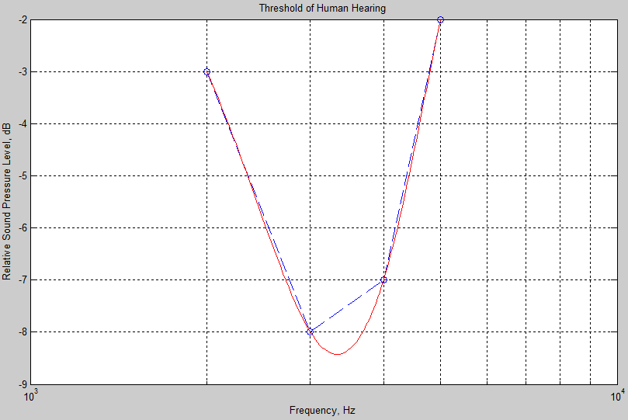
The spline interpolated data gives a closer approximation to the frequency at maximum sensitivity

Slide 7
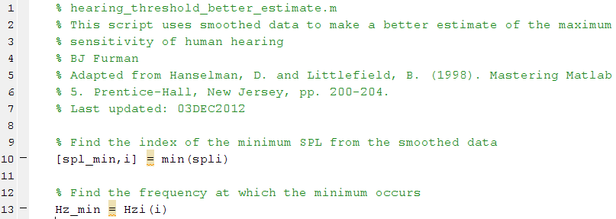
We can make a better estimate of the maximum sensitivity using the interpolated data

Slide 8
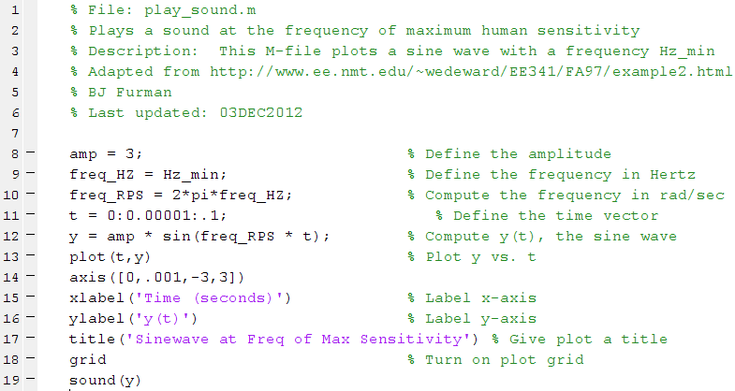
Matlab can play sound at Hz_min

